Slide 1
Northeastern University
Facebook
PRESENTED BY
Wenqing Liang | 001873144
Junling Gao | 001839851
Ashish Kumar | 001497334
Tripti Santani | 001497382
Dipti Bhattad | 001831210

Slide 2
Northeastern University
CONTENTS
FB Return Analysis
FB Price Analysis
Random Forest &Bootstrap
Trading Strategy
Risk Management
BACKGROUND
PART ONE
PART TWO
PART THREE
PART FOUR
PART FIVE
PART SIX

Slide 3
Northeastern University
BACKGROUND
PART ONE

Slide 4
PART ONE BACKGROUND
Facebook's initial public offering came on May 17, 2012, at a share price of US$38. The company was valued at $104 billion, the largest valuation to that date. The IPO raised $16 billion, the third-largest in U.S. history, after Visa Inc. in 2008 and AT&T Wireless in 2000.
Zuckerberg announced at the start of October 2012 that Facebook had one billion monthly active users, including 600 million mobile users, 219 billion photo uploads and 140 billion friend connections.
On October 13, 2013, Facebook acquired Onavo, an Israeli mobile web analytics company. Standard & Poor's added Facebook to its S&P 500 index on December 21.
In February 2014, Facebook announced that it would be buying mobile messaging company WhatsApp for US$19 billion in cash and stock.

Slide 5
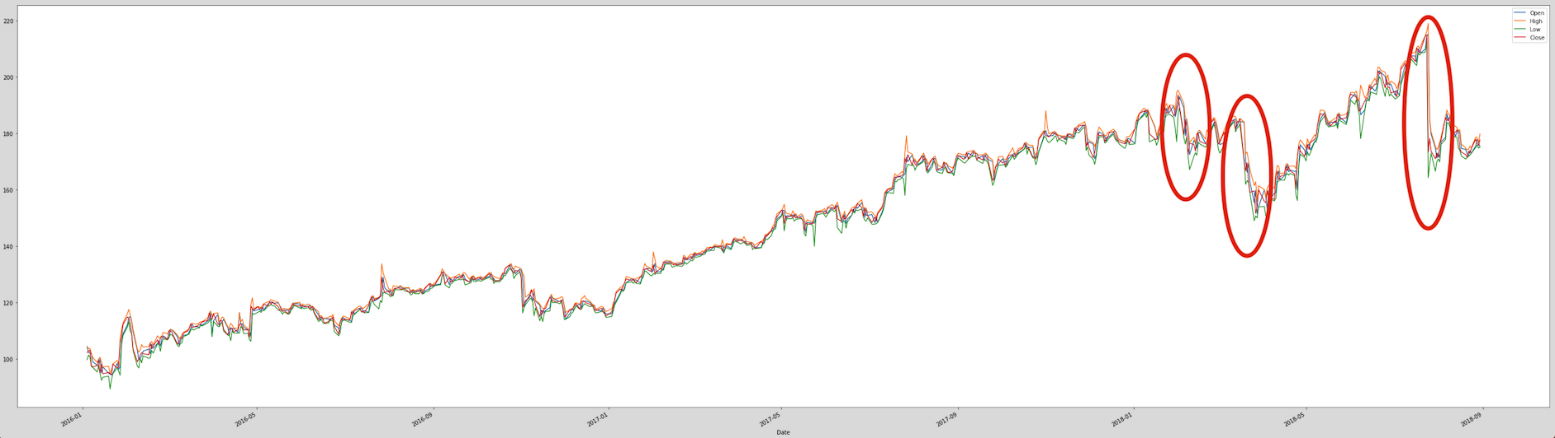
PART ONE Background
Before 2018
Event I
Cambridge Analytica
Scandal
Facebook reports Q2 earnings
Facebook‘share price is growing steadily and rapidly
Zuckerberg says that users spent less time on the platform
50 million accounts revealed to have been compromised by Cambridge Analytica
Total revenue-growth rates will continue to decelerate in the second half of 2018

Slide 6
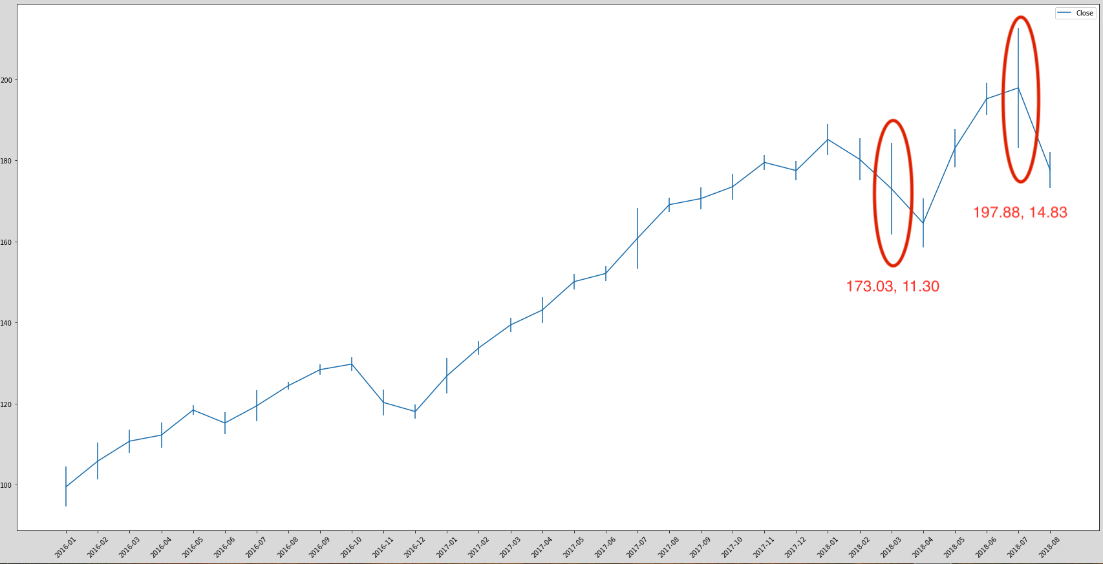
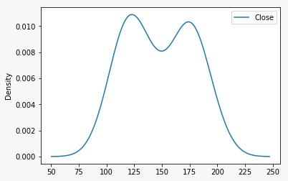
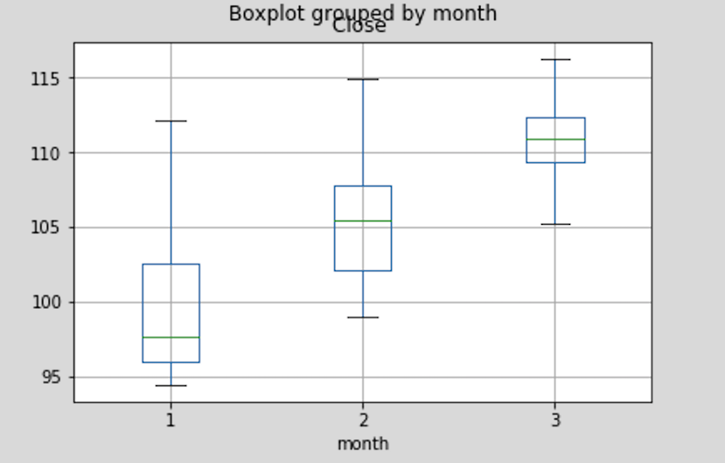
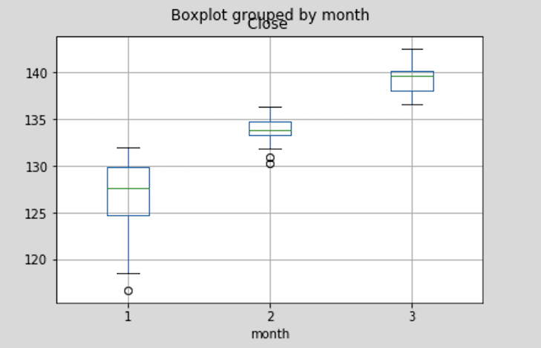
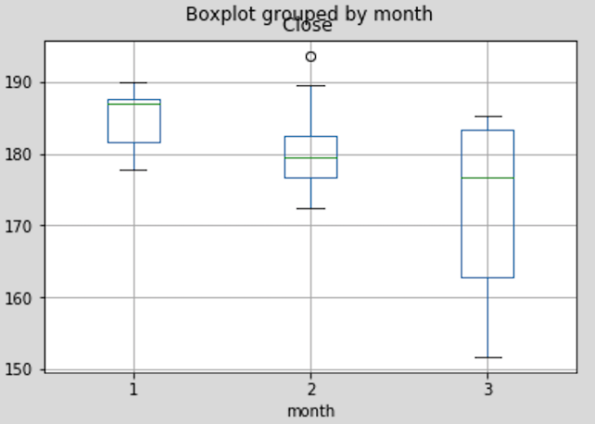
Stock Price -- Closing
2016 Q1
2017 Q1
2018 Q1

Slide 7
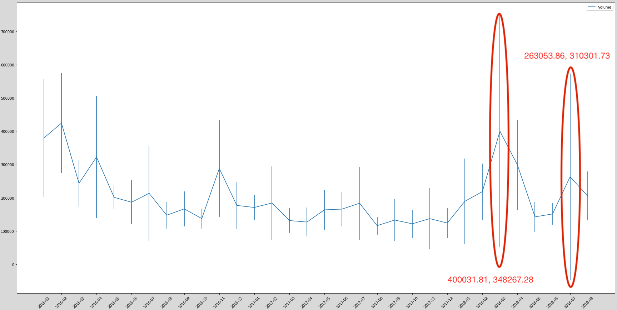
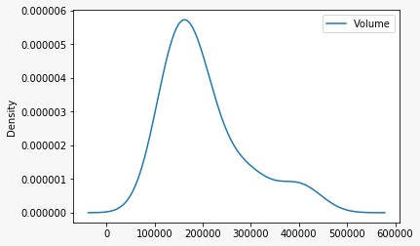
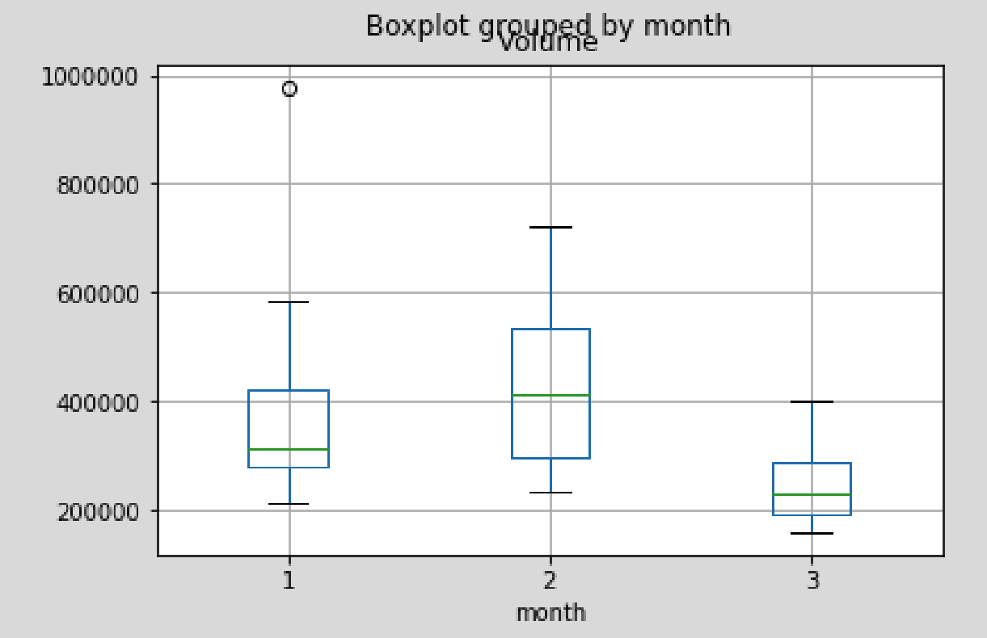
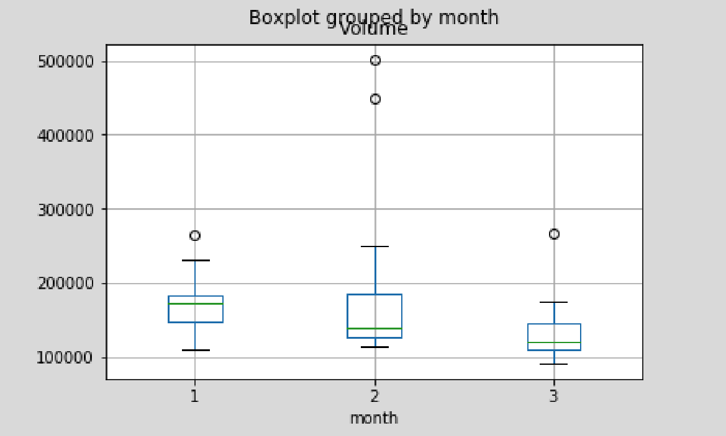
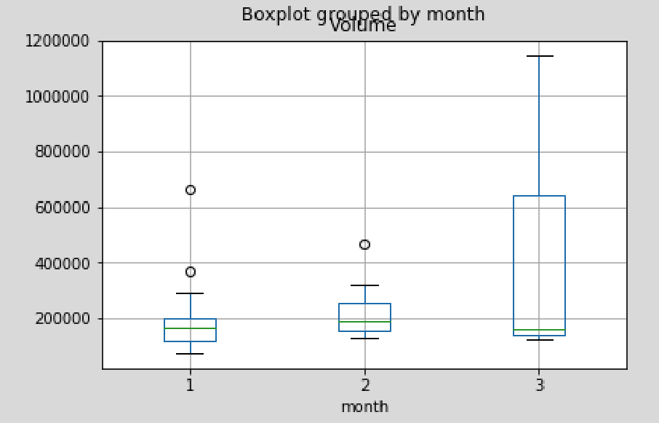
PART ONE Background
2016 Q1
2017 Q1
2018 Q1

Slide 8
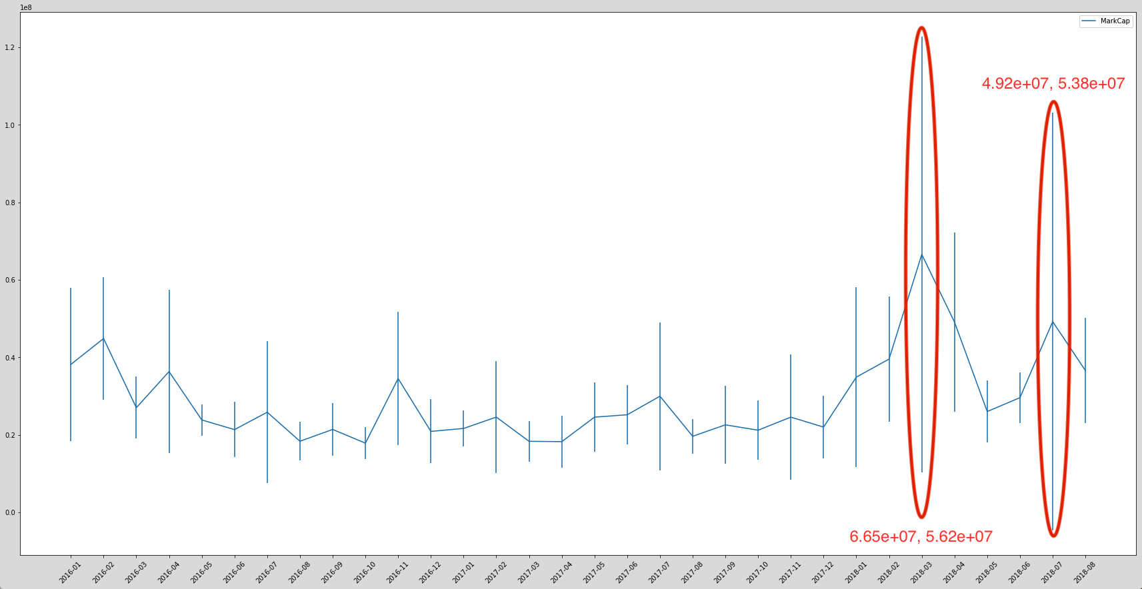
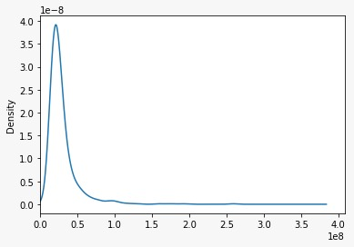
PART ONE Background
Density Plot

Slide 9
Northeastern University
Facebook Stock Return Analysis
PART TWO

Slide 10
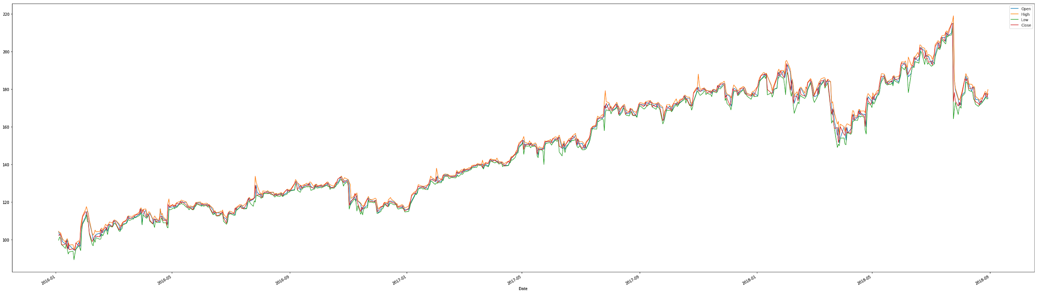
PART TWO Facebook Stock Return Analysis
Original Time Series (Price)

Slide 11

PART TWO Facebook Stock Return Analysis
Model for Return

Slide 12
PART TWO Facebook Stock Return Analysis
Models for Return
GARCH (1,1)
sigma2[t] = omega + alpha*(Y[t-1]-mu)**2 + beta*sigma2[t-1]
Y[t] = mu + err[t]*sqrt(sigma2[t])
GARCH_t[t] = 0.5*(log(2*pi) + log(sigma2[t]) + (Y[t]-mu)**2/sigma2[t])
GARCH
GARCH aims to minimize errors in forecasting by accounting for errors in prior forecasting, thereby enhancing the accuracy of ongoing predictions. This is the main reason for the wide use of GARCH model in finance.
GARCH-t (1,1)
sigma2[t] = omega + alpha*(Y[t-1]-mu)**2 + beta*sigma2[t-1]
Y[t] = mu + err[t]*sqrt(sigma2[t])
GARCH_t[t] = 0.5*(log(2*pi) + log(sigma2[t]) + (Y[t]-mu)**2/sigma2[t])

Slide 13
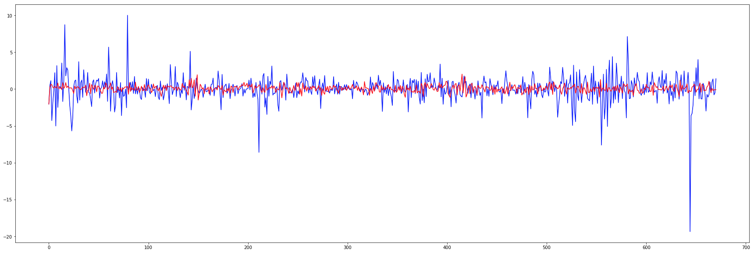
PART TWO Facebook Stock Return Analysis
GARCH (1,1) - Daily Return
Mu=0.1, Omega=2.5, Alpha=0.2, Beta=0.3
sigma2[t] = omega + alpha*(Y[t-1]-mu)**2 + beta*sigma2[t-1]
Y[t] = mu + err[t]*sqrt(sigma2[t])
GARCH_t[t] = 0.5*(log(2*pi) + log(sigma2[t]) + (Y[t]-mu)**2/sigma2[t])

Slide 14
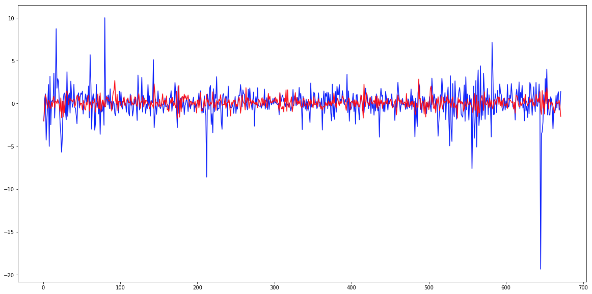
PART TWO Facebook Stock Return Analysis
GARCH-t (1,1) - Daily Return
Mu=0.1, Omega=2.5, Alpha=0.2, Beta=0.3, DF = 5
sigma2[t] = omega + alpha*(Y[t-1]-mu)**2 + beta*sigma2[t-1]
Y[t] = mu + err[t]*sqrt(sigma2[t])
GARCH_t[t] = 0.5*(log(2*pi) + log(sigma2[t]) + (Y[t]-mu)**2/sigma2[t])

Slide 15
PART TWO Facebook Stock Return Analysis
Models for Return
Kalman Filter
The filtering problem is that there is unobserved variable (a ''state'' variable) that evolves by some law of motion and there are observed variables that are related to the unobserved state. The Kalman Filter allows inference to be done in the basic state space model.

Slide 16
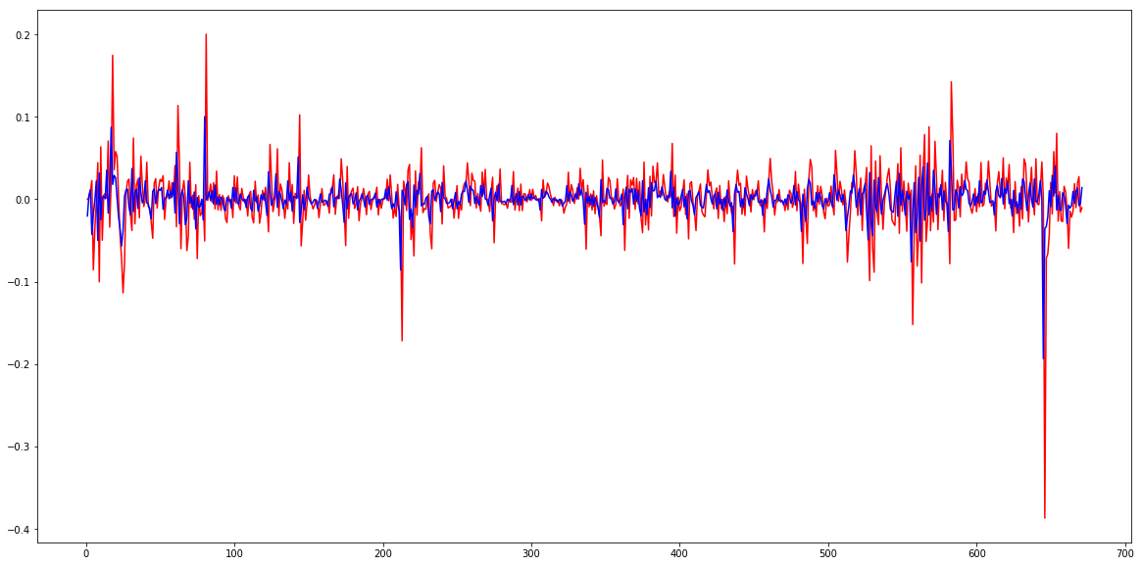
PART TWO Facebook Stock Return Analysis
Kalman Filer Return

Slide 17
PART TWO Facebook Stock Return Analysis
Models for Return
SVM
Obtain a nonlinear SVM regression model by replacing the dot product x 1′x 2 with a nonlinear kernel function G (x 1,x 2) = <φ (x 1),φ (x 2)>, where φ (x ) is a transformation that maps x to a high- dimensional space.

Slide 18
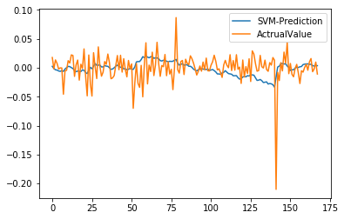
PART TWO Facebook Stock Return Analysis
SVM Return

Slide 19
Northeastern University
Facebook Stock Price Analysis
PART THREE

Slide 20
PART THREE Facebook Stock Price Analysis
Models for Price

Slide 21
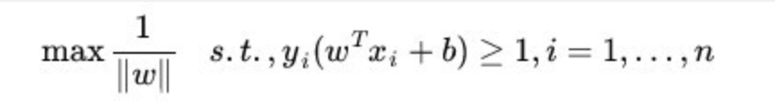
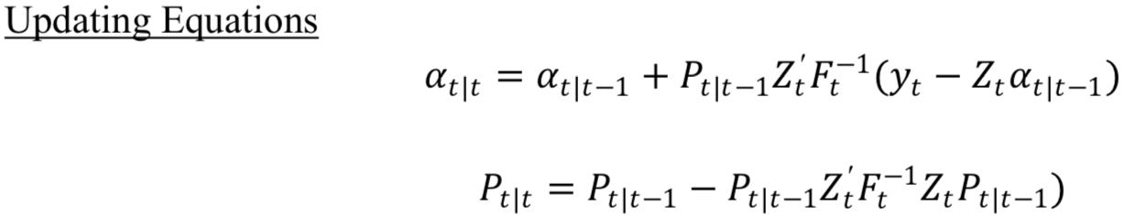
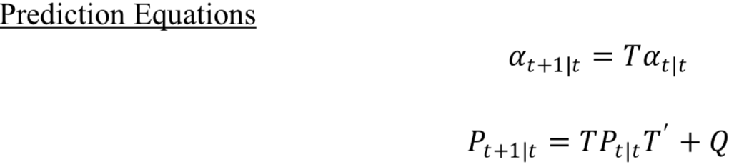
PART THREE Facebook Stock Price Analysis
Models for Price
AR1 & F-F
MACD
FB Prophet
AR1 : Yt+1= Yt + [Open-Close]t +
[High-Low]t +Volume(t) + ADS(t)
MACD=EMA_12-EMA_26
Yt=beta_hat0+beta_hat1*MACD+ut_hat
y(t)=g(t)+s(t)+h(t)+epsilon
F-F : Yt+1=Mkt-RF (t) + SMB(t) + HML (t) +ADS(t) + Percentage Change in Volume
Moving Average
SVM
Kalman Filter
uses a rolling average of ‘D’ days and ‘D-1’ days are not taken into consideration as they are used for calculation. So, if we calculate a 5 days moving average the 1st 4 days value will not be considered.
|yi−w∙ϕ(xi)−b| ≤ ϵ

Slide 22
PART THREE Facebook Stock Price Analysis
F-F & AR1

Slide 23
PART THREE Facebook Stock Price Analysis
F - F
Yt+1=Mkt-RF (t) + SMB(t) + HML (t) +ADS(t) + Percentage Change in Volume
beta_hat: [ 1.51993656e+02, 1.25366576e-02, -6.75698435e-01, -3.05525737e+00, 5.29167412e+01, -1.28690965e+00]
t_test: [ 1.50798981e+02, 9.59203728e-03, -3.43638725e-01, -1.64249352e+00, 1.60566019e+01, -5.02477264e-01]
p_val_t: [0.0, 0.9923496342306288, 0.7312258063716599, 0.1009569831720234, 0.0, 0.6154969494414058]
f_test: 6.480451452052192
p_val f_test: 6.785081437921114e-06
R2 and adj_R2: 0.2839158701495429 0.2785317789476598

Slide 24
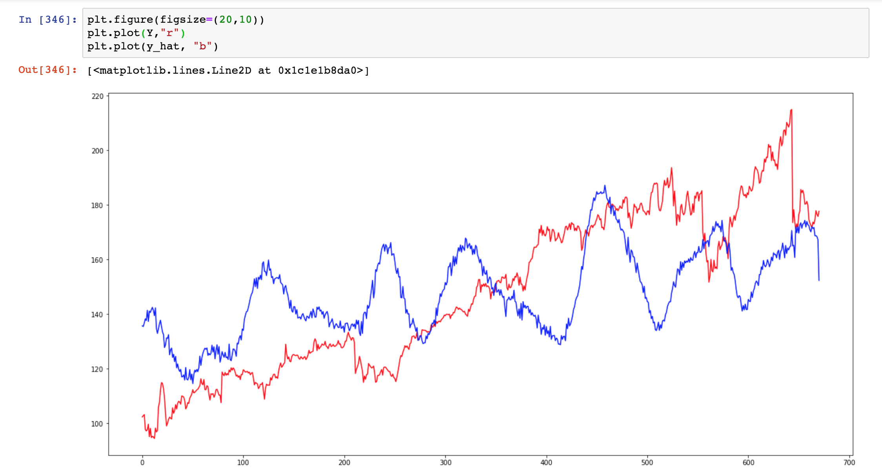
PART THREE Facebook Stock Price Analysis
F - F

Slide 25
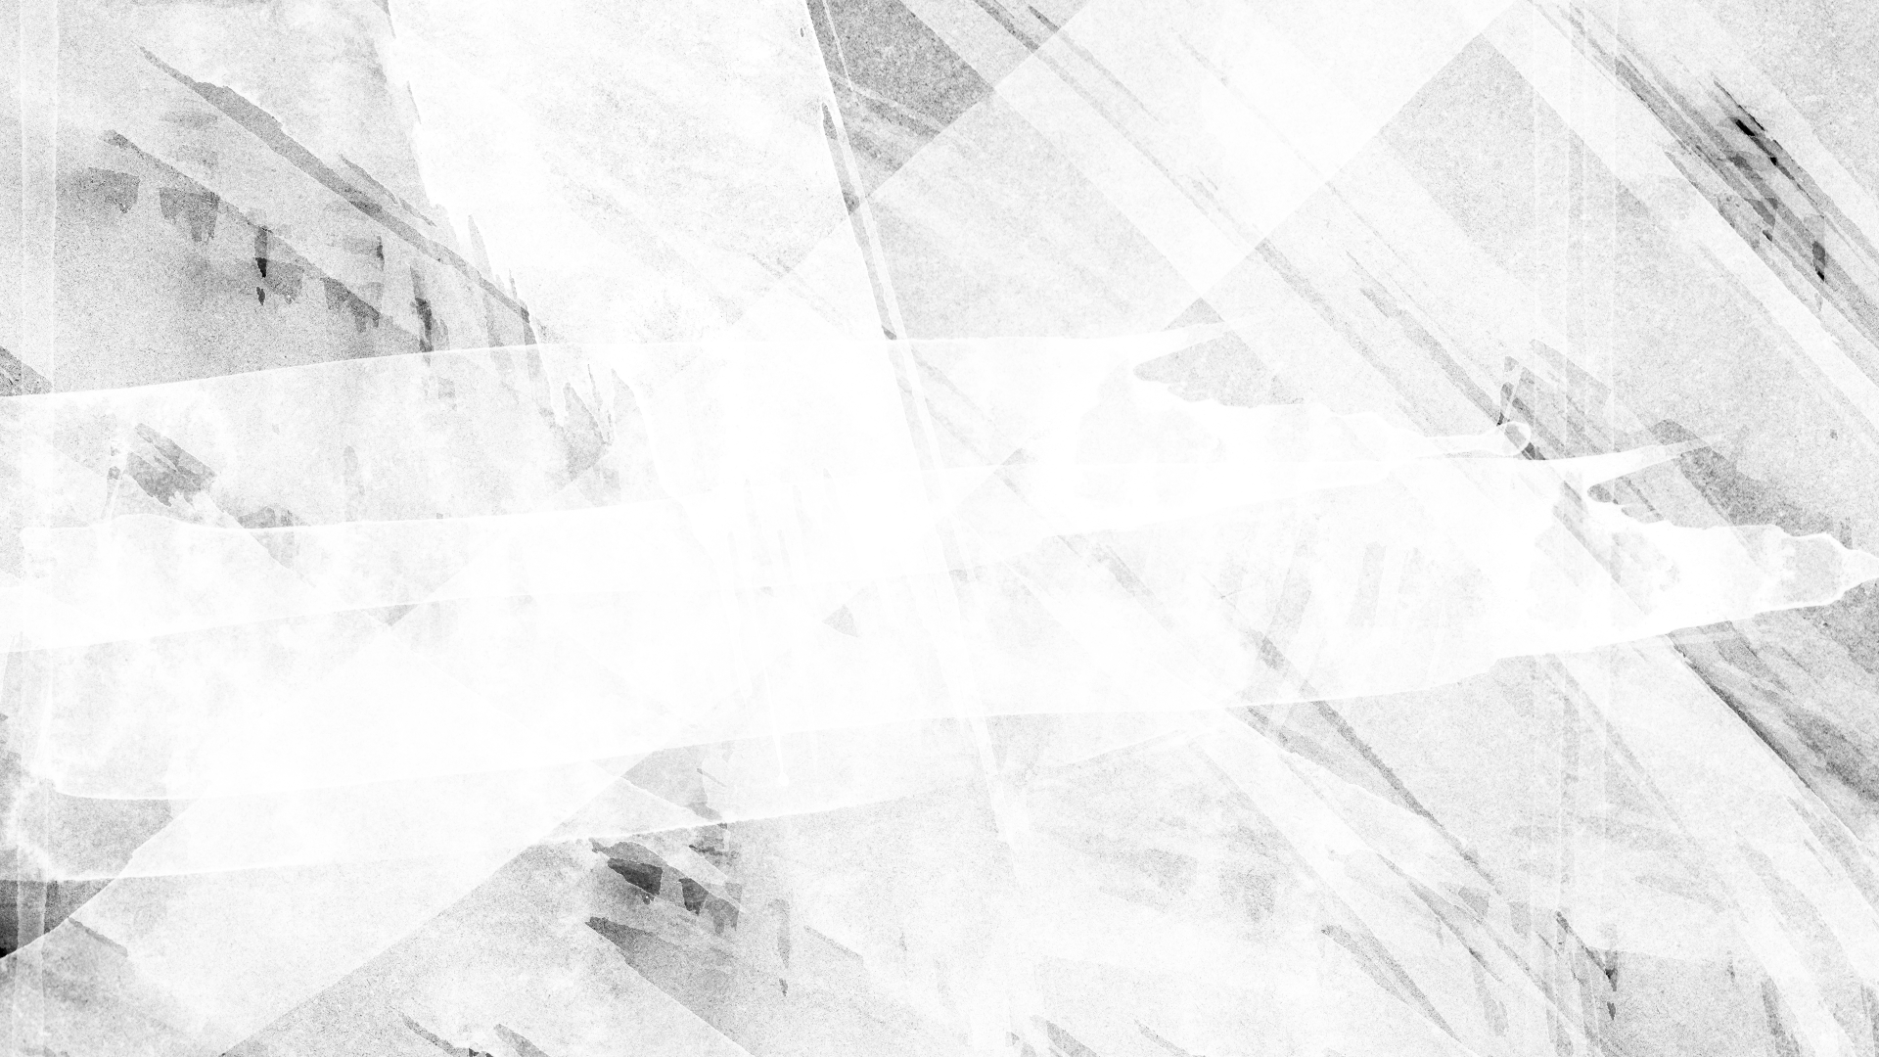
PART THREE Facebook Stock Price Analysis
AR1
Yt+1= Yt + [Open-Close]t + [High-Low]t +Volume(t) + ADS(t)
beta_hat:[ 3.97468545e-01, 9.97408109e-01, -9.40087859e-01, 9.92312838e-02, -1.13826300e-06, 5.84216810e-02]
t_test: [ 2.03954265e+00, 8.21545691e+02, -8.94836520e+01, 8.13056983e+00, -4.46183473e+00, 5.23482991e-01]
p_val t: [0.04178828109159505, 0.0, 0.0, 1.9984014443252818e-15, 9.532498746578355e-06, 0.6008115364530675]
f_test: 9835376.462412778
p_val f: 1.1102230246251565e-16
R2 and adj_R2: 0.999412364428967 0.9994079461164028

Slide 26
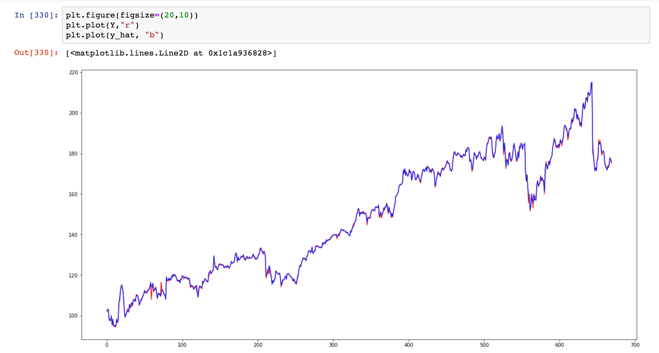
PART THREE Facebook Stock Price Analysis
AR1

Slide 27
PART THREE Facebook Stock Price Analysis
Moving Average

Slide 28
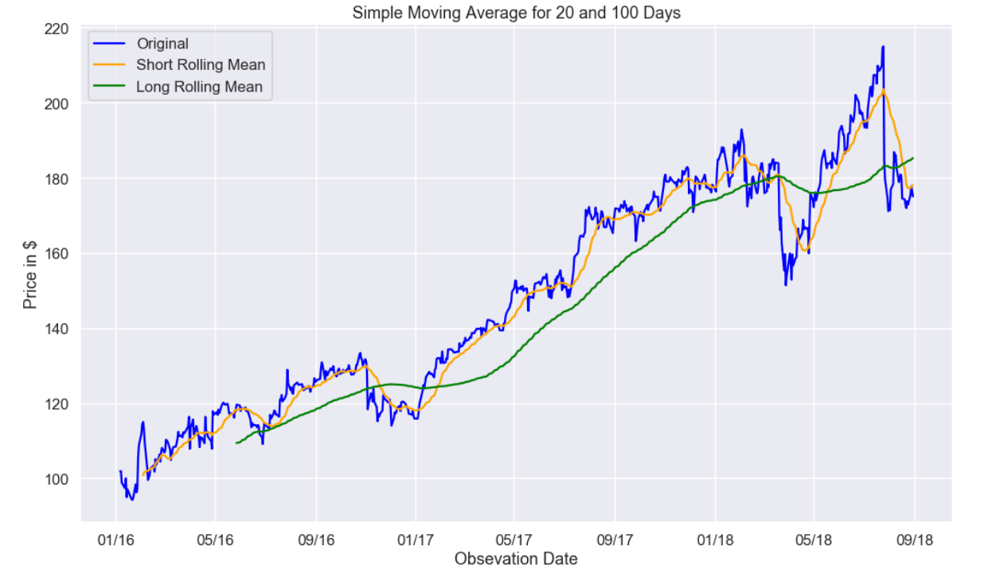
PART THREE Facebook Stock Price Analysis
Simple Moving Average
Simple Moving Average Strategy SMA is one of the simplest trading strategies. As the name implies this technique uses a rolling average of 'D' days and 'D-1' days are not taken into consideration as they are used for calculation. So, if we calculate a 5 days moving average the 1st 4 days value will not be considered.

Slide 29
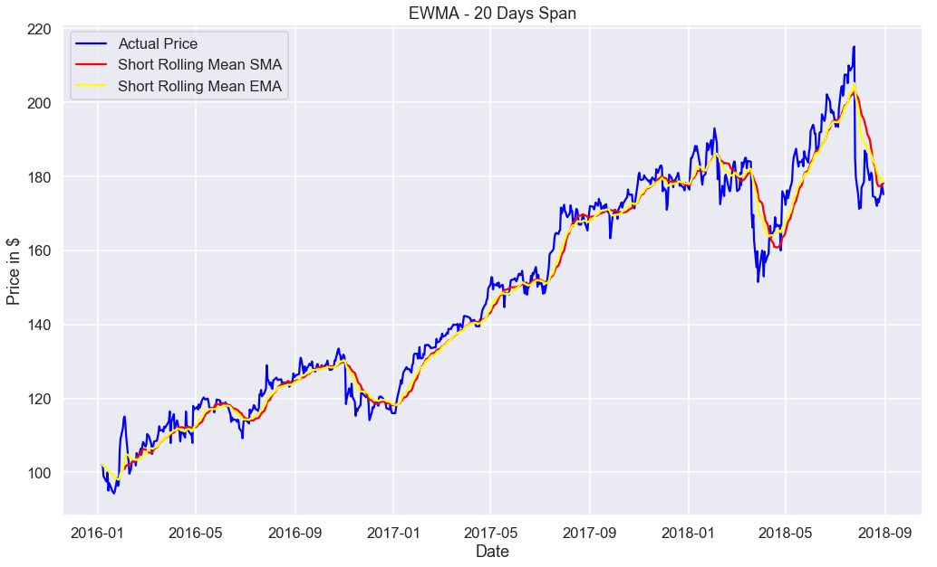
PART THREE Facebook Stock Price Analysis
Exponential Moving Average

Slide 30
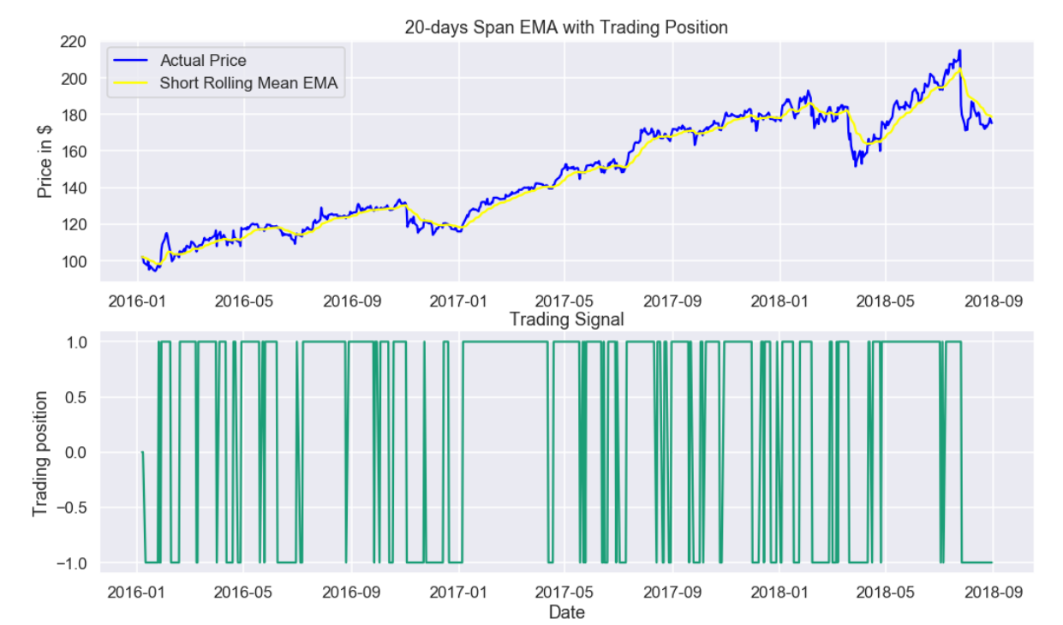
PART THREE Facebook Stock Price Analysis
Exponential Moving Average

Slide 31
PART THREE Facebook Stock Price Analysis
Formula Generated by Moving Average
Yt=beta_hat0+beta_hat1*EMA(5)+ut_hat
beta_hat: [0.31200208 0.99937186]
t_test: [0.66375096 320.45974407]
p_val_t: [0.5070783847241129, 0.0]
f_test: 246966.0915409867
p_val f_test: 1.1102230246251565e-16
R2 and adj_R2: 0.9935469361780442 0.9935372903427349

Slide 32
PART THREE Facebook Stock Price Analysis
MACD

Slide 33
PART THREE Facebook Stock Price Analysis
MACD
MACD=EMA_12-EMA_26
Yt=beta_hat0+beta_hat1*MACD+ut_hat
beta_hat: [130.20514192, 6.34232591]
t_test: [4.64227744, 0.39132399]
p_val_t: [1.72294867e-06, 3.47778883e-01]
f_test: 246966.0915409867
p_val f_test: 1.1102230246251565e-16
R2 and adj_R2: 0.1327984474205529, 0.1310570788410761

Slide 34
PART THREE Facebook Stock Price Analysis
FB Prophet

Slide 35
PART THREE Facebook Stock Price Analysis
FB Prophet
Prophet is a time series forecasting technique developed by Facebook
Based on trend+seasonality+holidays
y(t)=g(t)+s(t)+h(t)+epsilon
Where g(t)=linear growth curve for modelling non periodic changes in time series
s(t)=periodic changes(eg. Weekly, yearly)
h(t)=effect of holidays with irregular schedules
epsilon=error term

Slide 36
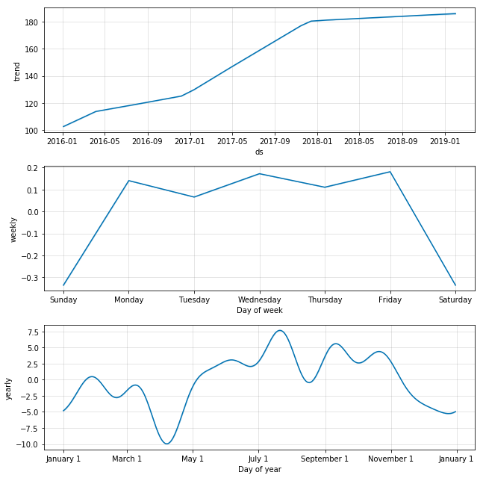
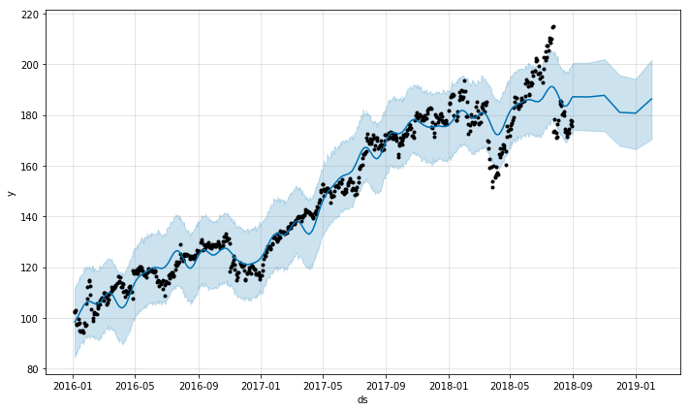
PART THREE Facebook Stock Price Analysis
FB Prophet
R2= 0.9543450026962081

Slide 37
PART THREE Facebook Stock Price Analysis
SVM

Slide 38
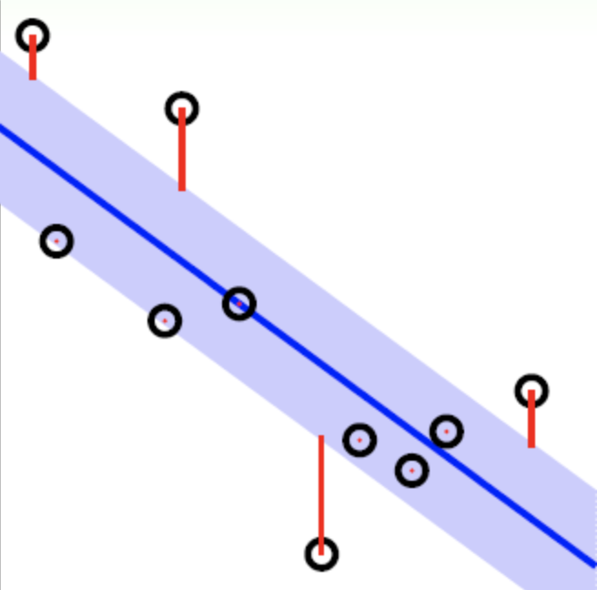
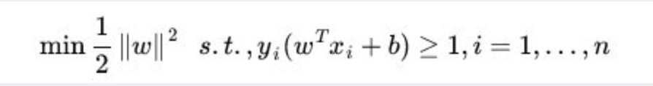

PART THREE Facebook Stock Price Analysis
SVM
For Classification:
For Regression: |yi−w∙ϕ(xi)−b| ≤ ϵ
Paras: Open, High, Low
Target: Daily Return Rate
Mean Squared Error : 0.000686
Paras: Close Price (Yesterday), (High Price - Low Price) (Yesterday)
Target: Open Price (Next Day)
Mean Squared Error : 0.000686
R2 : 0.9981317349570867
Mean Squared Error = 0.305

Slide 39
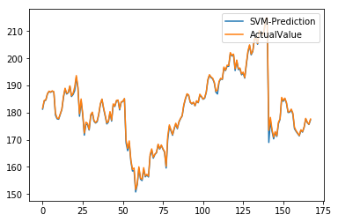
PART THREE Facebook Stock Price Analysis
SVM

Slide 40
PART THREE Facebook Stock Price Analysis
Kalman Filter

Slide 41
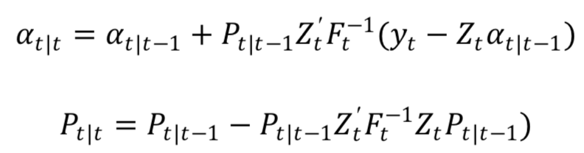
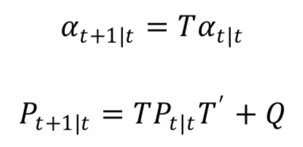
PART THREE Facebook Stock Price Analysis
Kalman Filter
Updating Equations :
Prediction Equations：
R2 : 0.9822244749544563

Slide 42
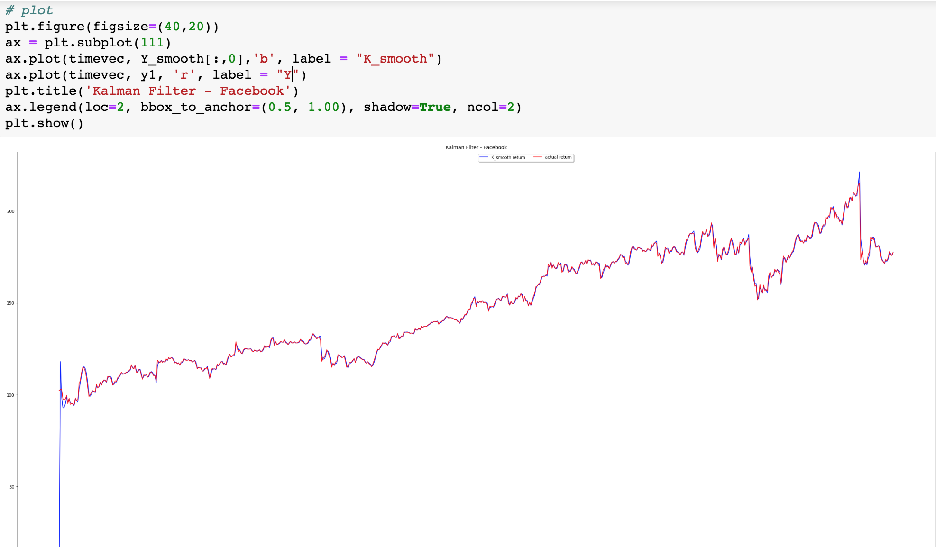
PART THREE Facebook Stock Price Analysis
Kalman Filter

Slide 43
Northeastern University
Bootstrap & Random Forest
PART FOUR

Slide 44
PART FOUR Bootstrap & Random Forest
Bootstrap

Slide 45
PART FOUR Bootstrap & Random Forest
Method
For each day (t) :
Y[t-200: t-1] → Bootstrap & Run Model
Predict Y[t] in each model
Calculate RMSE

Slide 46
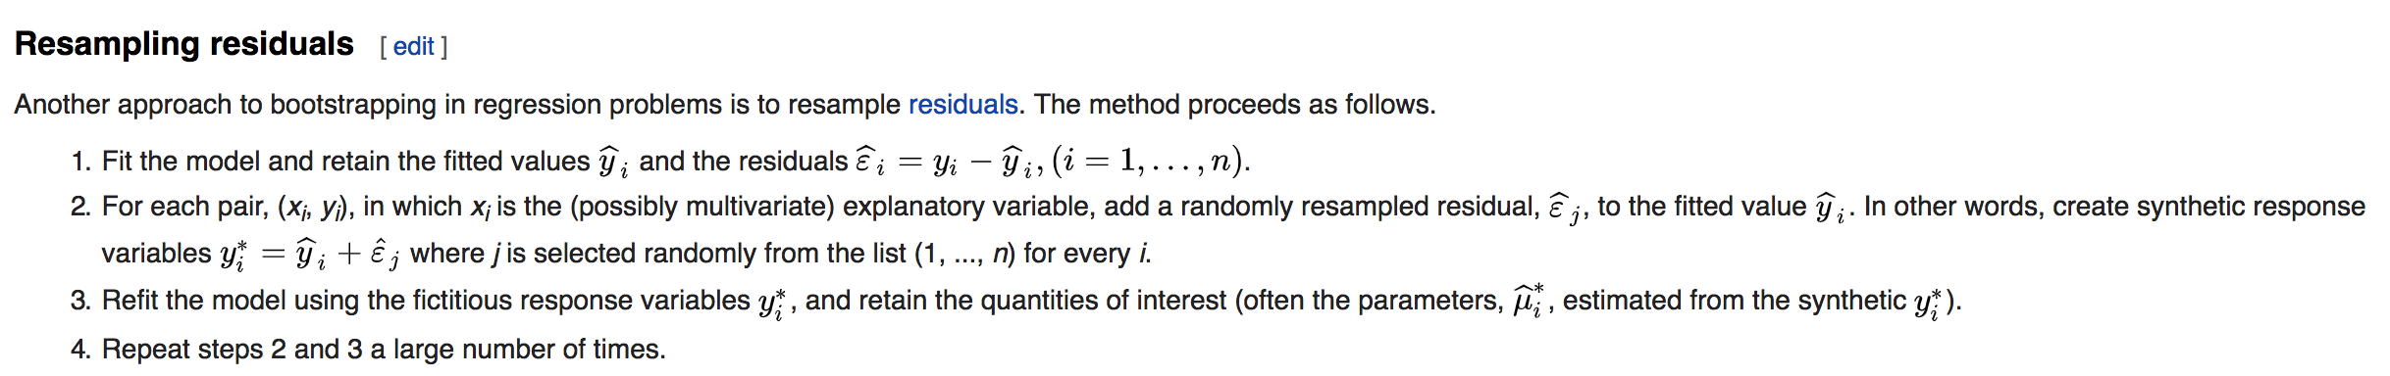
PART FOUR Bootstrap & Random Forest
Method
Bootstrap Method: Resampling Residuals
Assumption: Residuals are independent and identically distributed (iid)
https://en.wikipedia.org/wiki/Bootstrapping_(statistics)

Slide 47
PART FOUR Bootstrap & Random Forest
Random Forest

Slide 48
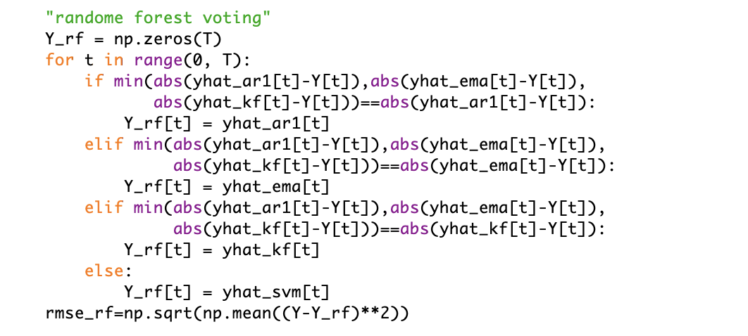
PART FOUR Bootstrap & Random Forest
Random Forest
Pick 4 Models to Run the Random Forest:
AR1
EMA
Kalman Filter
SVM

Slide 49
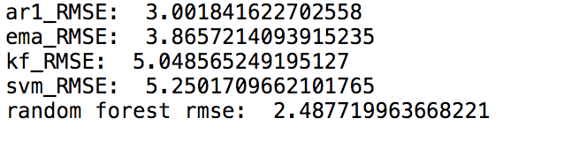
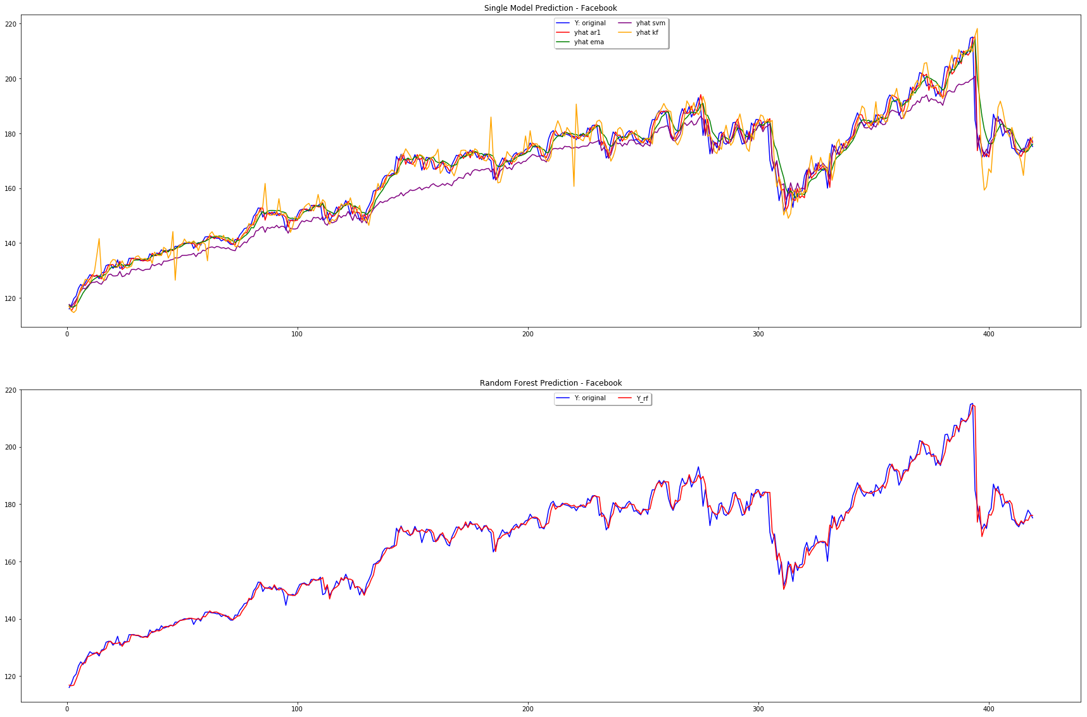
PART FOUR Bootstrap & Random Forest
Random Forest Results

Slide 50
PART FIVE Trading Strategy
Trading Strategy
PART Five

Slide 51
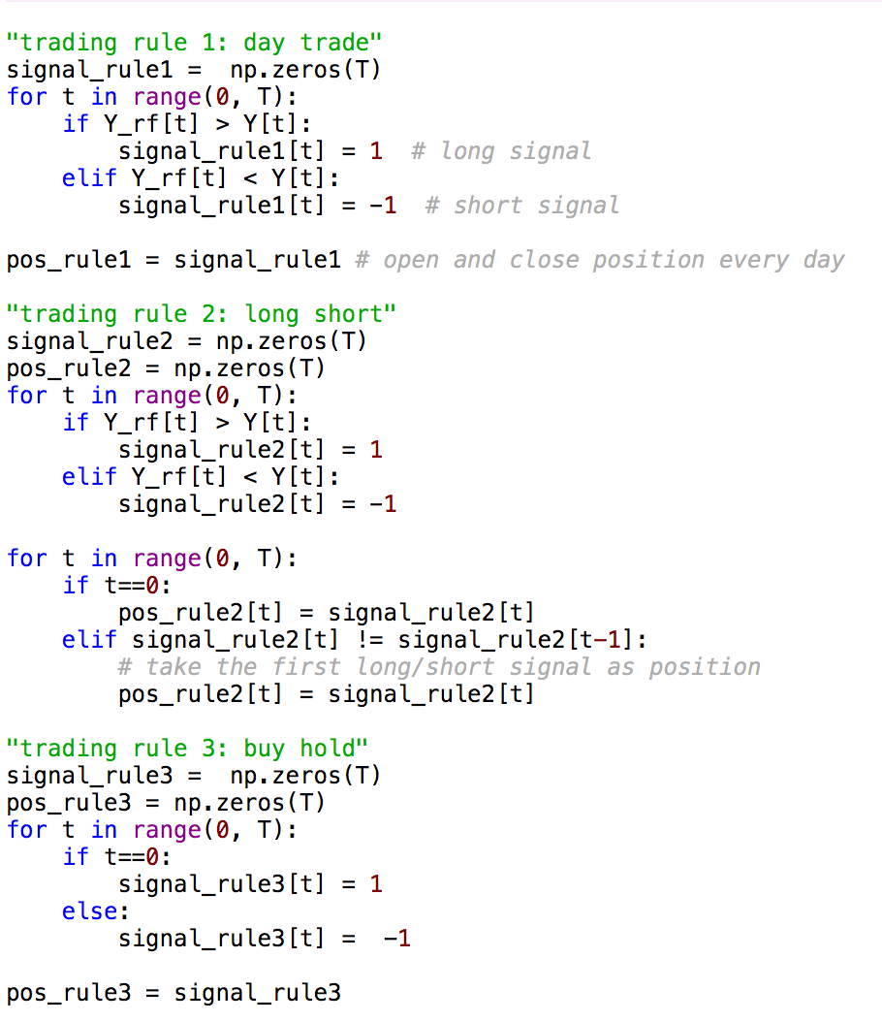
PART FIVE Trading Strategy
DAY
TRADE
LONG SHORT
BUY
HOLD

Slide 52
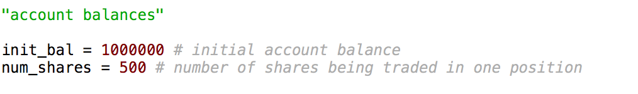
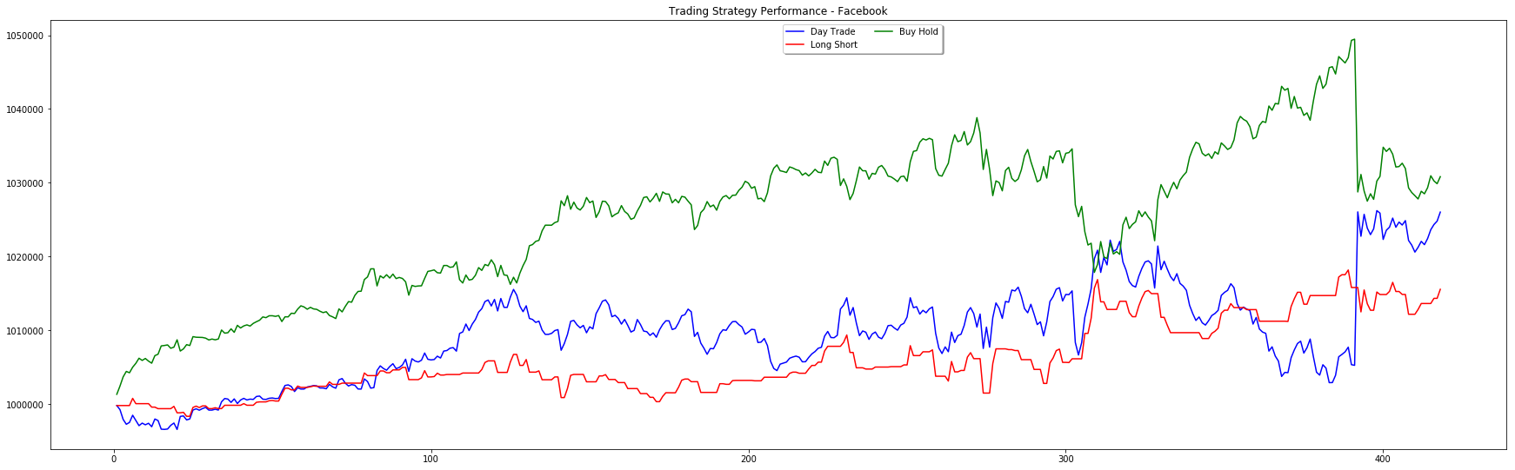
PART FIVE Trading Strategy

Slide 53
PART SIX Risk Management
Risk Management
PART Six

Slide 54
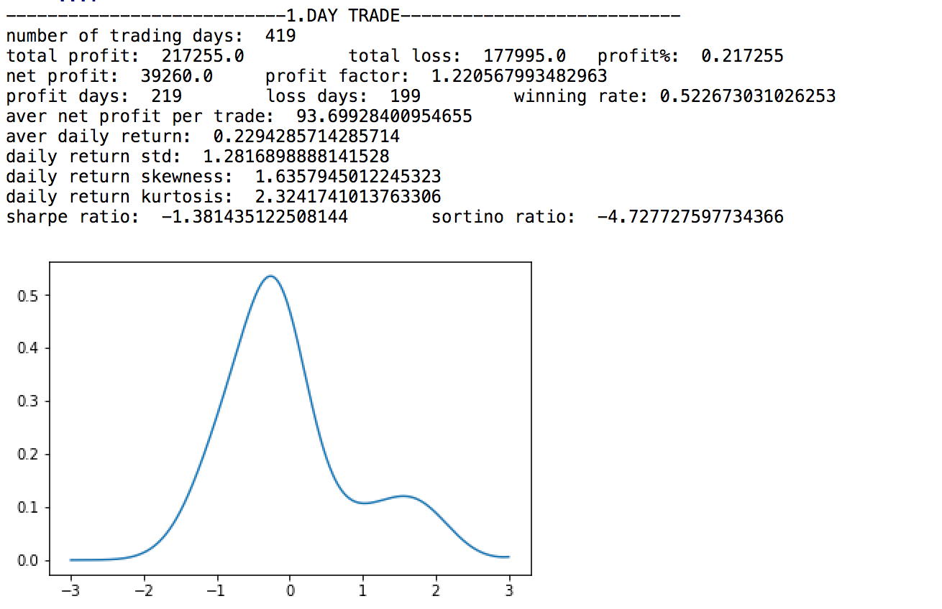
PART SIX Risk Management
DAY
TRADE

Slide 55
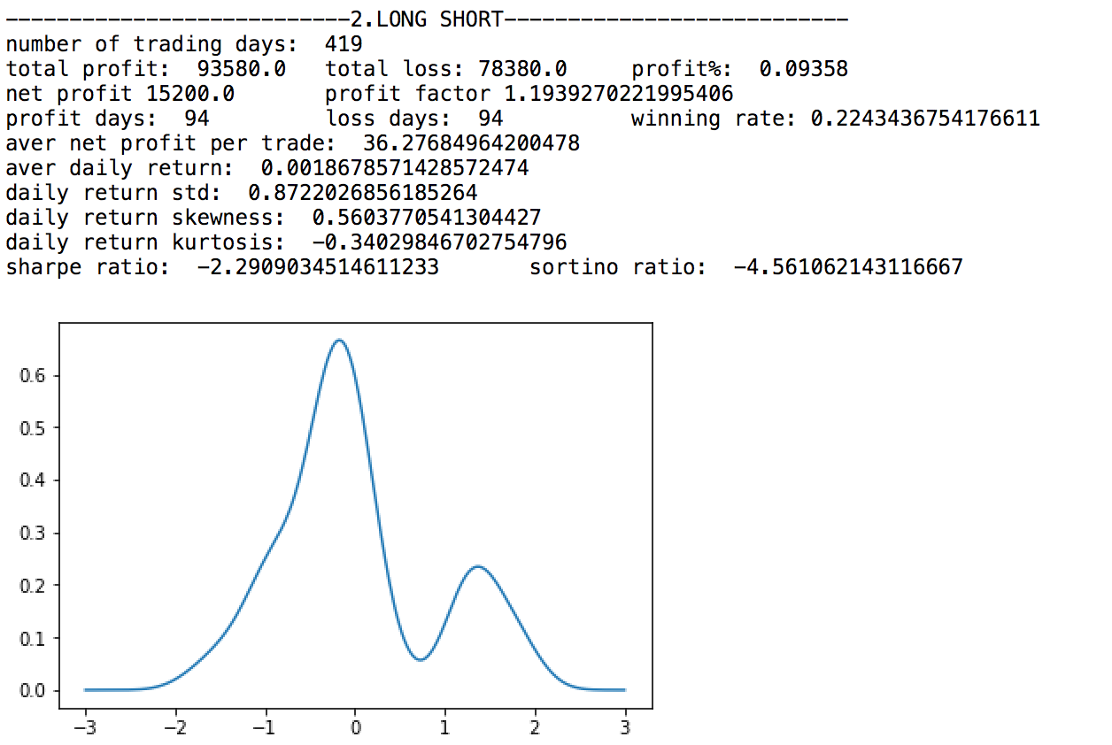
PART SIX Risk Management
LONG SHORT

Slide 56
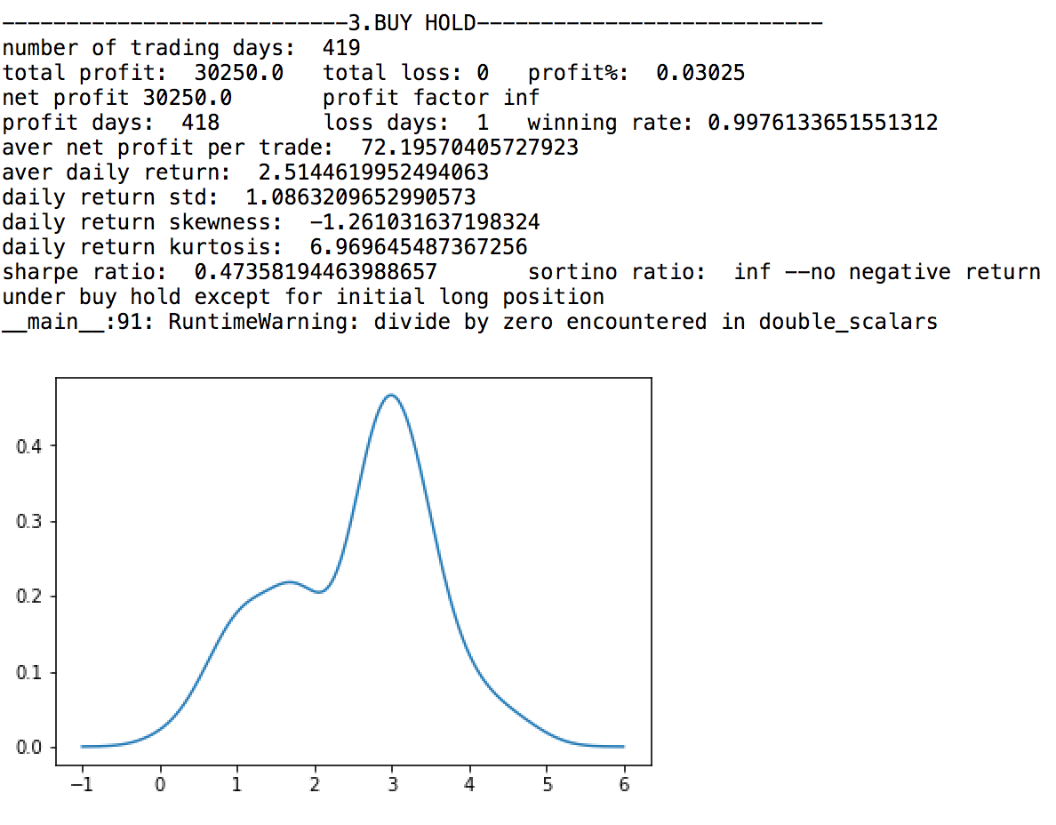
PART SIX Risk Management
BUY
HOLD

